Slide 1
Session 5 White-Box Testing (3)
chengbaolei@suda.edu.cn

Slide 2
Objectives
Review of Session 3-4
Basic Concepts of White-Box Testing
Logic Coverage
Control Flow Graph
Basis Path Testing
Loop Testing
Data Flow Testing

Slide 3
3.1 Basic Concepts
White-box testing must follow several principles:
All independent path in a module must be implemented at least once. (Basis path testing)
All logic values require two test cases: true and false. (Logic coverage)
Inspection procedures of internal data structure, and ensuring the effectiveness of its structure.
(Static Testing + Data Flow Testing)
Run all cycles within operational range. (Loop testing)

Slide 4
3.2 Logic Coverage
Logic coverage
Statement coverage
Decision coverage
Condition coverage
Condition/decision coverage
Condition combination coverage
Path coverage
Complete coverage
Notes:
逻辑覆盖是通过对程序逻辑结构的遍历实现程序的覆盖。

Slide 5
3.3 Control Flow Graph
Concept
During procedure design , in order to more prominent the control flow structure, the procedure can be simplified, the simplified graph is called control flow graph. (vs. program flow graph)
On a flow graph:
Arrows called edges represent flow of control.
Circles called nodes represent one or more actions.
Areas bounded by edges and nodes called regions.
A predicate node is a node containing a condition.

Slide 6
3.4 Basis Path Testing
How to design test cases for basis path testing
Using the design or code, draw the corresponding control flow graph.
Determine the cyclomatic complexity of the flow graph.
Determine a basis set of independent paths.
Prepare test cases that will force execution of each path in the basis set.

Slide 8
3.5 Loop Testing
Simple Loops
Nested Loops
Concatenated Loops
Unstructured Loops

Slide 9
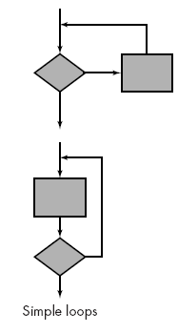
3.5 Loop Testing – Simple Loops
The following set of tests can be applied to simple loops, where n is the maximum number of allowable passes through the loop.
Skip the loop entirely.
Only one pass through the loop.
Two passes through the loop.
m passes through the loop where m < n.
n - 1, n, n + 1 passes through the loop

Slide 10
Example
int iSum(int j)
{
int i=1, s=0, a=100;
while (i<=j && i<=a)
{
s=s+i;
i=i+1;
}
return s;
}
Test Case 1: j=0 实际循环0次
Test Case 2: j=1 实际循环1次
Test Case 3: j=2 实际循环2次
Test Case 4: j=50 实际循环50次
Test Case 5: j=99 实际循环99次
Test Case 6: j=100 实际循环100次
Test Case 7: j=101 实际循环100次

Slide 11
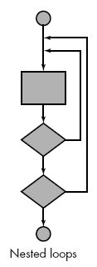
3.5 Loop Testing – Nested Loops
Start at the innermost loop. Set all other loops to minimum values.
Conduct simple loop tests for the innermost loop while holding the outer loops at their minimum iteration parameter (e.g., loop counter) values.
Work outward, conducting tests for the next loop, but keeping all other outer loops at minimum values and other nested loops to "typical" values.
Continue until all loops have been tested.

Slide 12
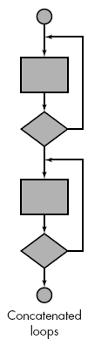
3.5 Loop Testing – Concatenated Loops
If each of the loops is independent of the other:
Concatenated loops can be tested using the approach defined for simple loops,
Else
the approach applied to nested loops is recommended.

Slide 13
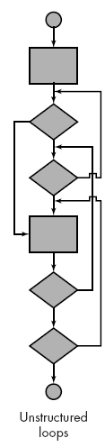
3.5 Loop Testing – Unstructured Loops
Suggestion: whenever possible, this kind of loops should be redesigned.
avoid to use “go to” control construct.

Slide 14
3.5 Loop Testing
The easy way to test loops is using the method Z path coverage.
Z path coverage method is a program in Loop structure will be simplified into IF structure test method.
Simplify cycle test only once, or zero times. In this case, the effect of loop structure and IF branches are same, namely the loop body or execution, or skip.
Notes:
Z 路径覆盖法是一种将程序中循环结构简化成选择结构的测试方法。
循环简化的目的是限制循环次数，无论循环的形式和循环体实际执行的次数，简化后的循环测试只考虑循环一次或者零次两种情况。
在这种情况下，循环与判定分支的效果是一样的，即循环要么执行，要么跳过。

Slide 15
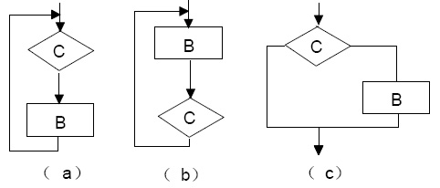
Example

Slide 16
3.5 Loop Testing
Loop Testing & Basis Path Testing
(3) for(int i=1; i<arraty_size; i++)
3.1
3.2
3.3

Slide 17
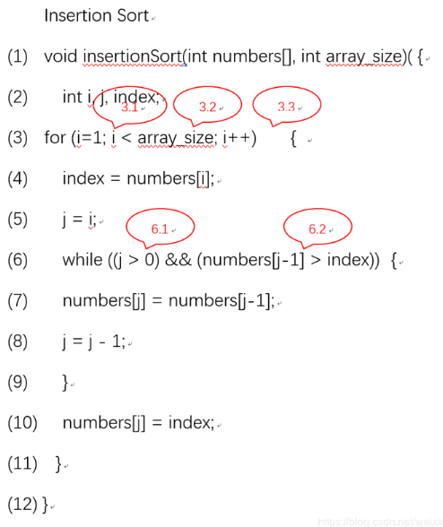
3.5 Loop Testing
Update CFG

Slide 18
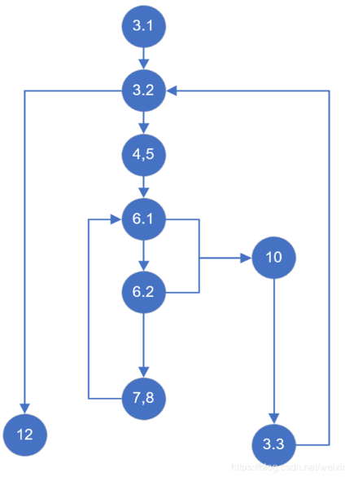
3.5 Loop Testing

Slide 19
3.5 Loop Testing
路径1：3.1–3.2–12
路径2：3.1–3.2–4,5–6.1–10–3.3–3.2–12
路径3：3.1–3.2–4,5–6.1–6.2–10–3.3–3.2–12
路径4：3.1–3.2–4,5–6.1–6.2–7,8–6.1–10–3.3–3.2–12
程序中6.1在未进入while循环自减时j=1恒成立，故不存在任何数据能使程序执行路径2.

Slide 20
In session 3-5, you have learned
Basic Concepts of White box testing
Logic Coverage
Control Flow Graph
Basis Path Testing
Loop Testing
Data Flow Testing

